Slide 1
No Quiz today! :(
AI Generated Imagery

Slide 2
Today’s objectives
Clarify any grading worries for Assignment 4
Discuss interests for special topics for last two weeks & final project
AI & Image processing
Human-facing applications (the basic, the good, the troublesome)
Designing image-focused applications
Research update

Slide 3
Special Topics Brainstorm: What would you like to learn more about?
GANs
Generated things, sound, design, images
Deep fakes
Collaborating with AI, workplace, driving, design collab
Gesture detection
AI for AR/VR
Designers in the ML development loop, UX research testing AI methods
More interactive trying stuff out
Adversarial tricking image classifiers, Adversarial Attacks

Slide 4
Final projects brainstorm: system project or essay options. What are you interested in?
Combine HW5 with final project
Choose your own
Interactive tool
Interpretability
Speculative design
Create blog post
Investigating a topic
Design speculative fiction

Slide 5
“Simple” object recognition
Applications include:
Sorting and indexing your photos
Gathering and labeling data
What else?

Slide 6
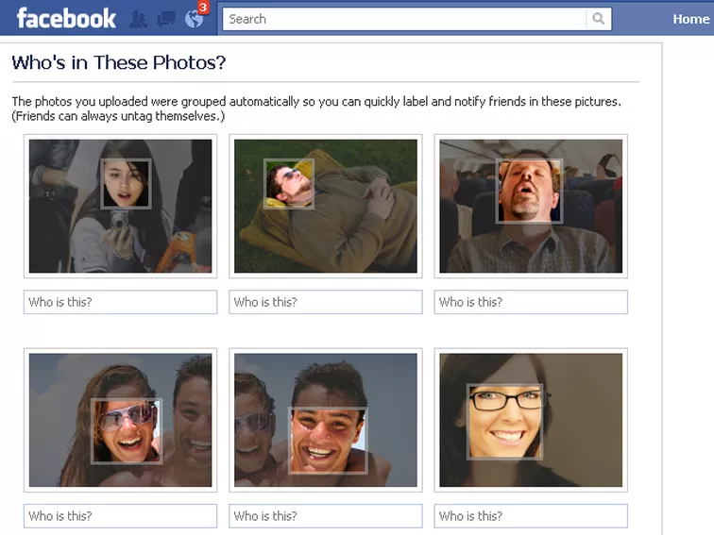
Face recognition (Facebook 2011)
Facial recognition has been a staple of computer vision tasks since the 1960s
What elements identify a face?
What would an algorithm need to identify the same face across different images?
Notes:
Image source: https://www.cnet.com/how-to/how-to-disable-facial-recognition-in-facebook/

Slide 7
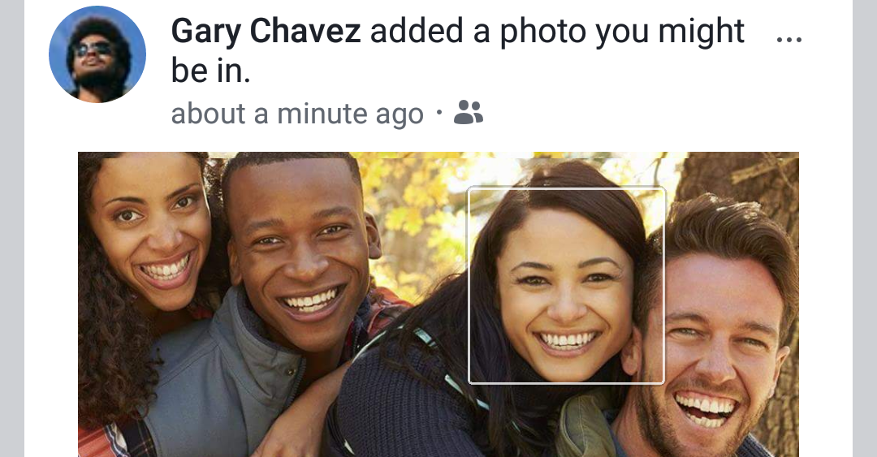
Face recognition (Facebook 2019)
As of October 2019 Facebook is facing a $35B class action lawsuit. Why?
The state of Illinois has a law that individuals have to consent to having their biometrics (including face) collected and scanned by AI.
$35B = $1-5000 per 7 million users in Illinois
May go to supreme court.
Notes:
Image source: https://techcrunch.com/2019/10/18/facebook-35-billion-lawsuit/

Slide 8
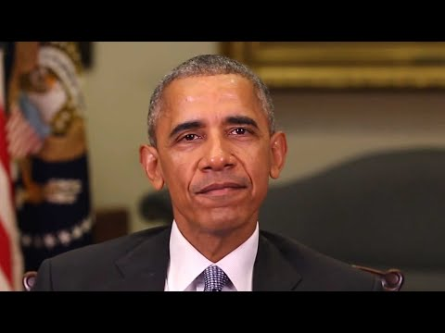
Human Deep Fakes (2018)
[Warning: video contains harsh political satire]
This video helped set off a bit of a public scare around deep fakes.
Notes:
https://www.theverge.com/tldr/2018/4/17/17247334/ai-fake-news-video-barack-obama-jordan-peele-buzzfeed

Slide 9
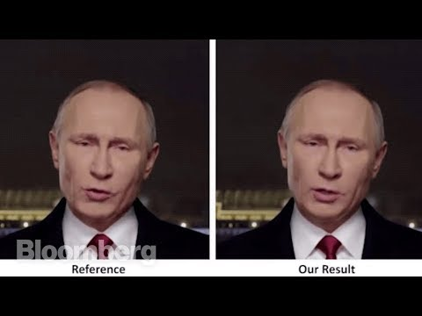
Broader scope of Deep Fakes (2018)
What do you think about the implications?
E.g. currently this will work best with people with a lot of existing video or audio content to train on

Slide 10
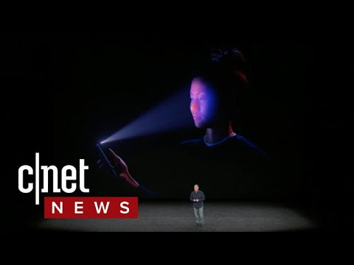
Your face as your secure identity (2017)
Apple FaceID uses facial recognition to unlock your devices.
What are some benefits of face over other password input?
What are some scenarios where this could go wrong?

Slide 11
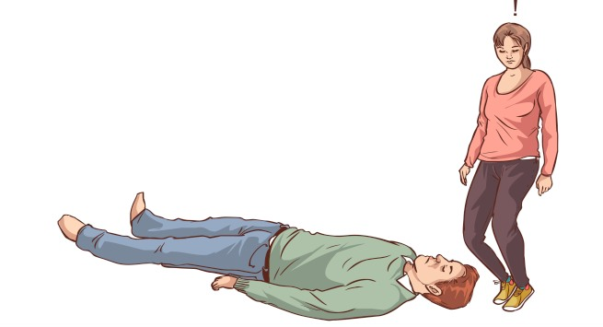
Liveness detection: is the image a live awake person
Fraud detection:
Are you a mask?
Or a doll?
Or unconscious?
Or a static image?
Bob is unconscious. Can Alice break into Bob’s phone and bank account?
Notes:
Image source: https://www.thehealthsite.com/photo-gallery/diseases-conditions-first-aid-how-to-place-a-person-in-recovery-position-step-by-step-guide-b1217-545374/

Slide 12
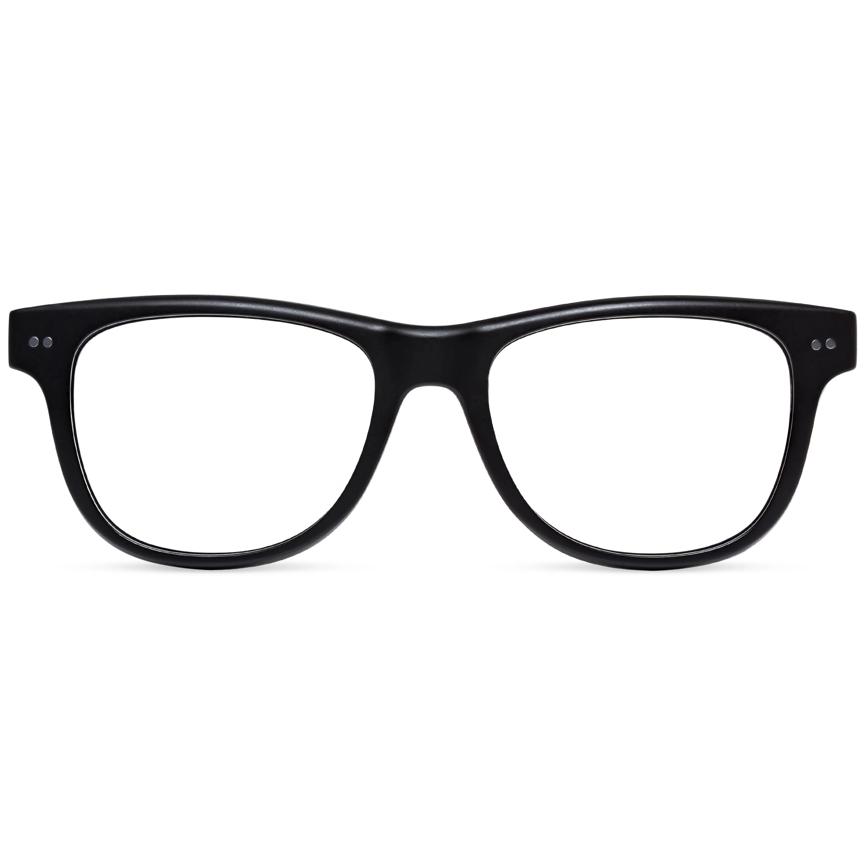
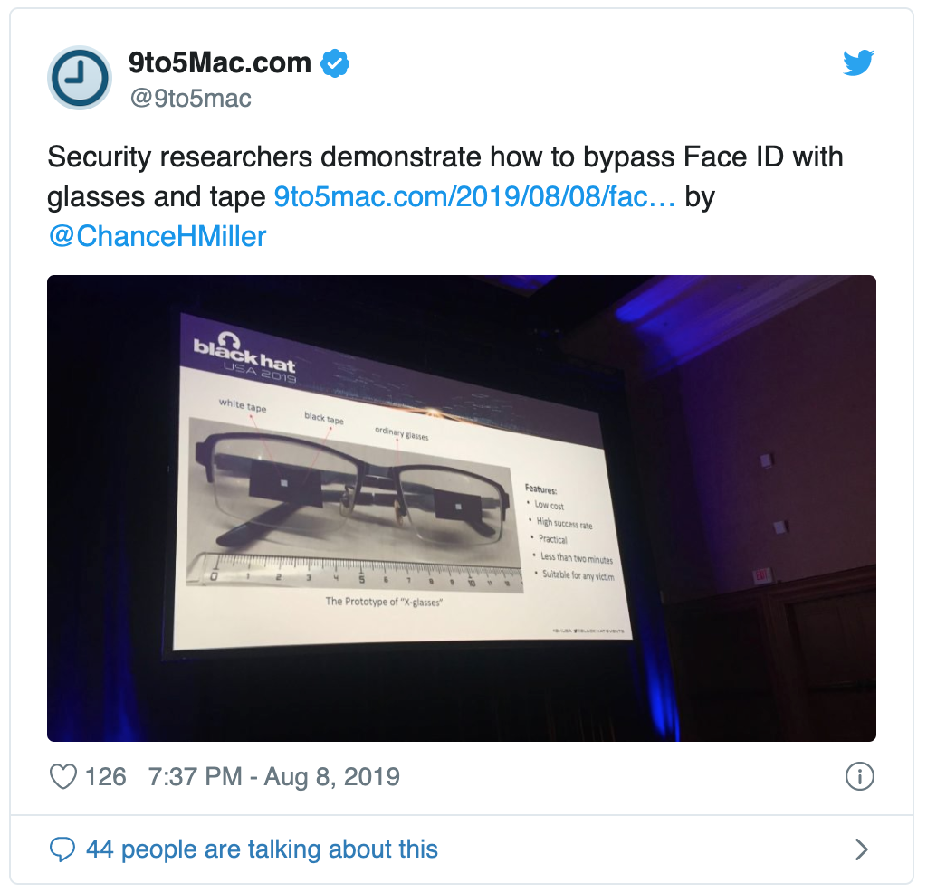
Liveness detection: is the image a live awake person (2019)
Bob is unconscious. Can Alice break into Bob’s phone and bank account?
Yes!
Notes:
Image source: https://www.thehealthsite.com/photo-gallery/diseases-conditions-first-aid-how-to-place-a-person-in-recovery-position-step-by-step-guide-b1217-545374/
https://www.lookoptic.com/products/sullivan-black

Slide 13
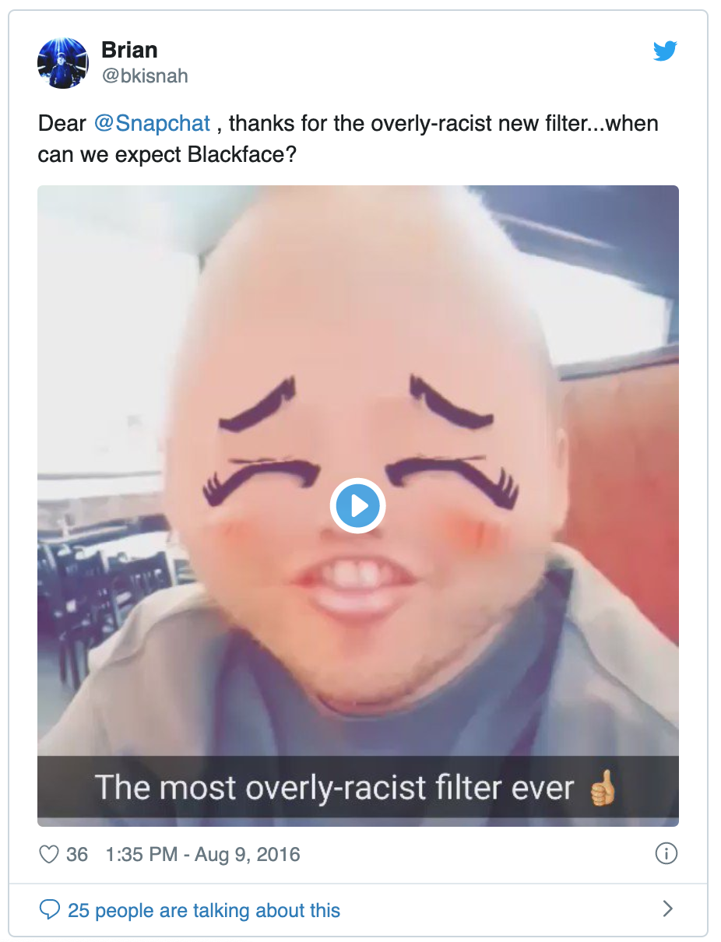
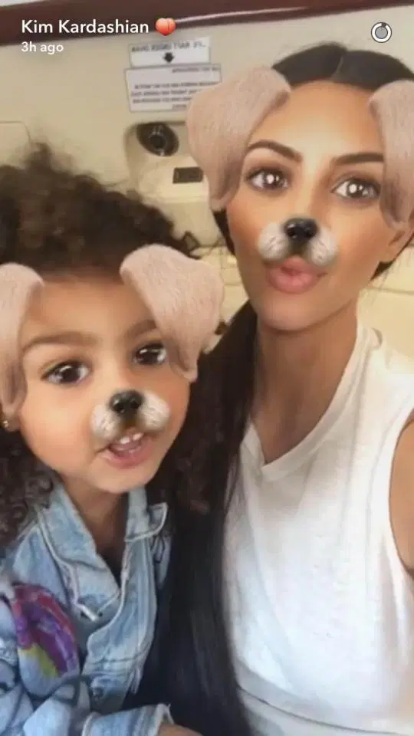
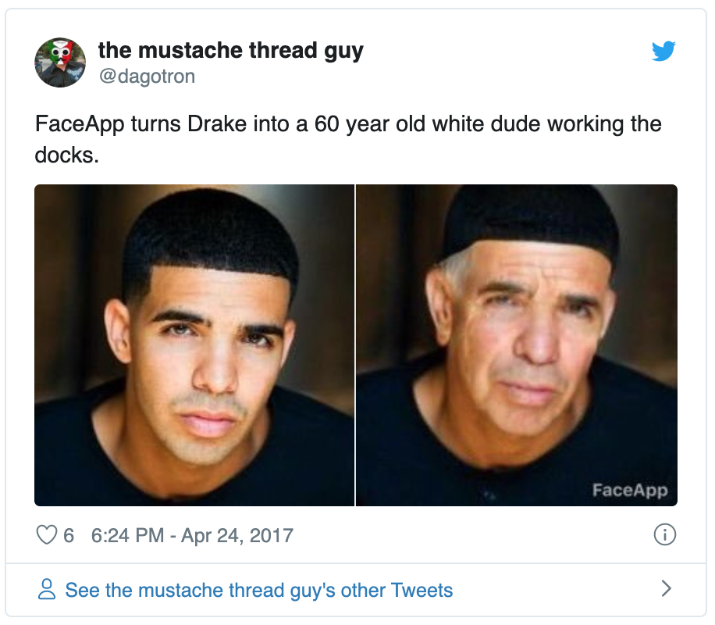
Image Fun!
Image filter games and apps make great social media and meme material.
Privacy implications?
Racial implications?

Slide 14
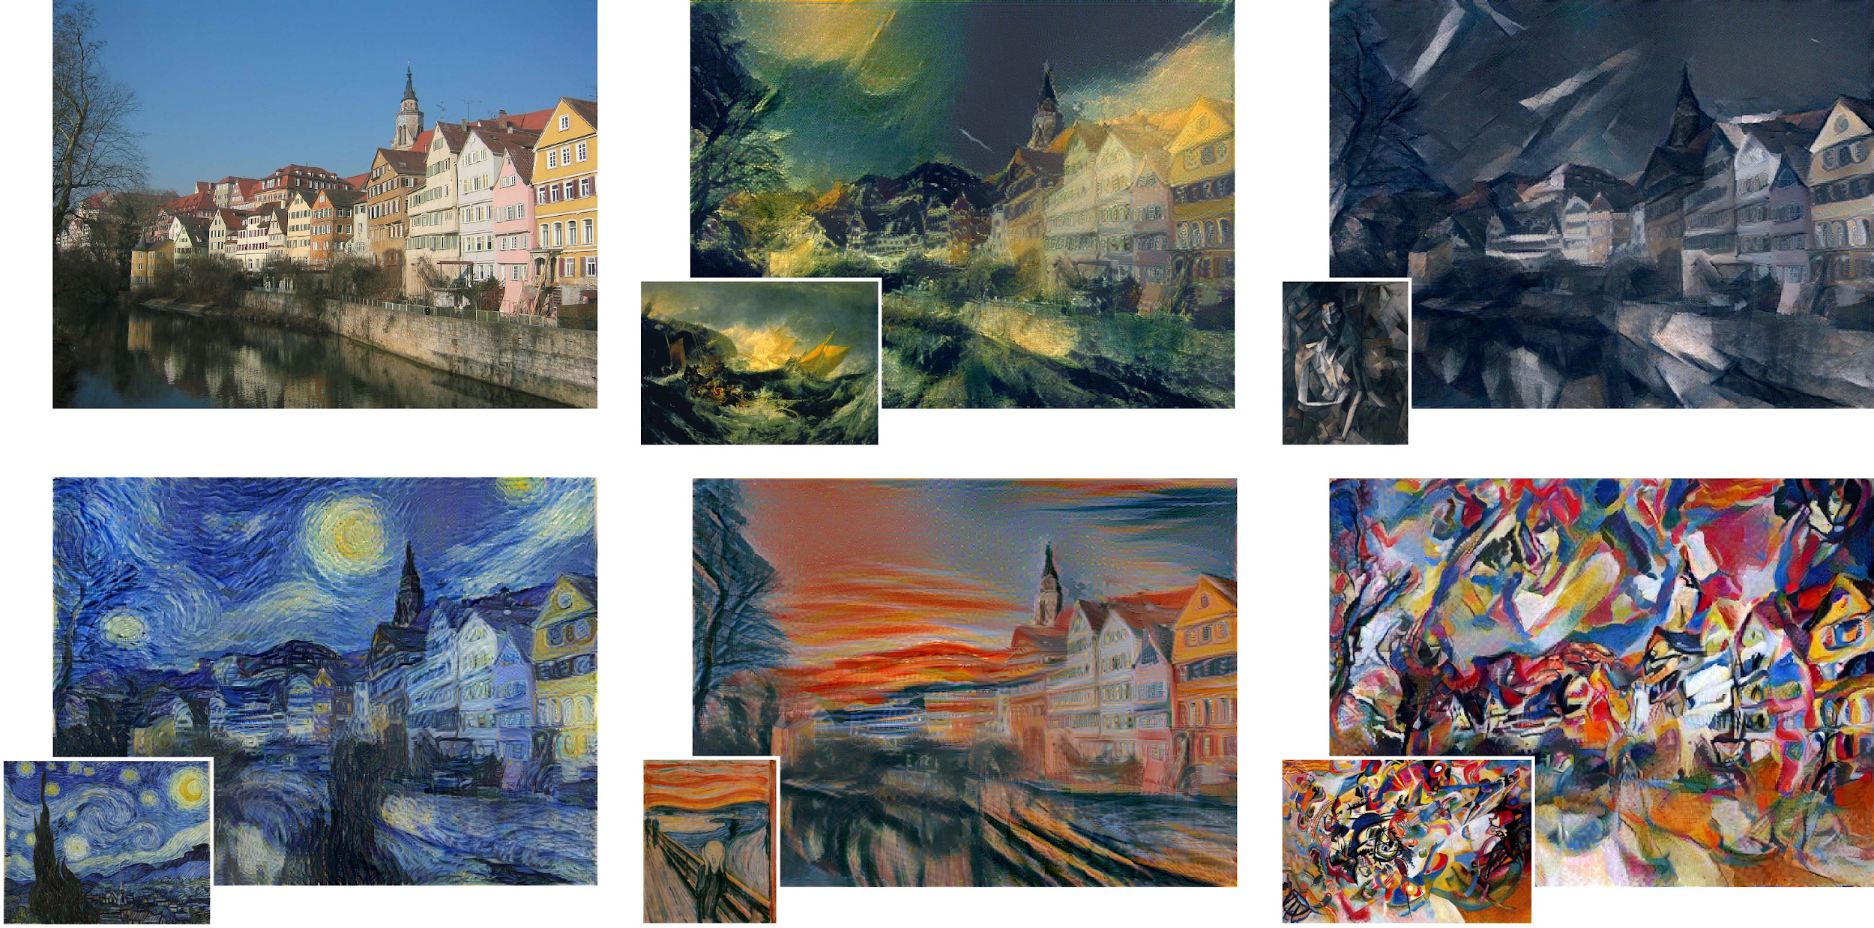
Style transfer
Neural Net is trained to learn a particular style.
We use transfer learning to apply that learned style to a new image to stylize it.
More examples: https://deepart.io/latest/
Notes:
image : http://bethgelab.org/research/machine_learning/style_transfer/

Slide 15
Designing an image based app (continued next class)
Prompt: A camera-based app to detect and deter porch thieves
What will be the appeal of the app?
What are some constraints to look out for?
What kinds of tasks might this app do for the porch thief problem?
Design the general flow of the service for the end user’s experience
Detail technical requirements to enable these experiences.

Slide 16
Research Update! HW 5 to be released Thursday
HW5 will involve generating fake images & manipulating images
We will be trying out a notebook tool to record your results

